Slide 1

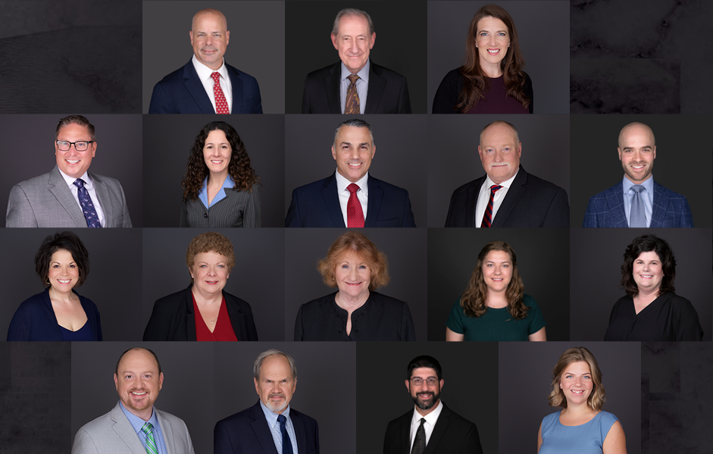
Merry Christmas,
from the MtM Family

Slide 2

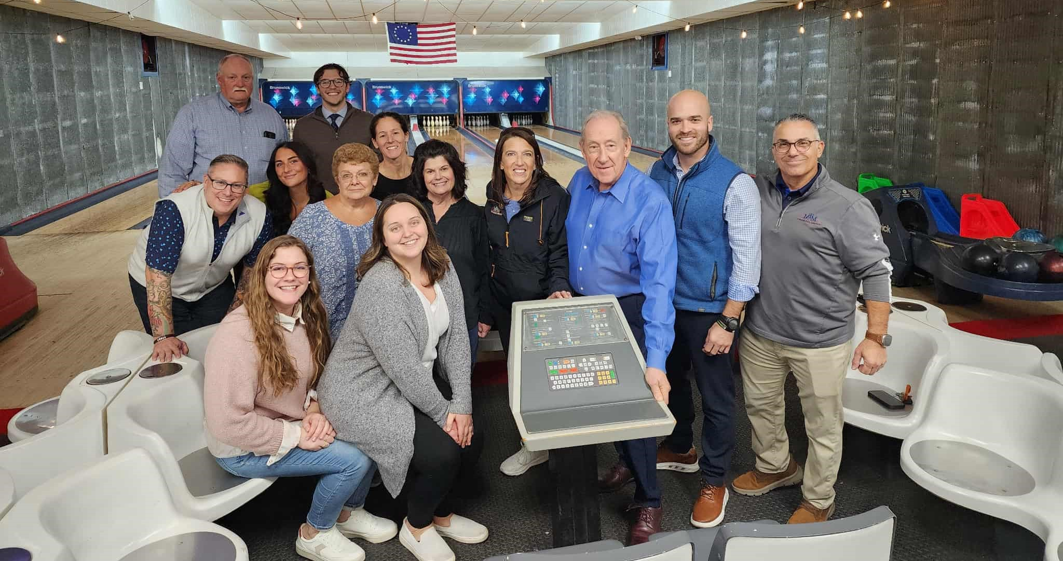
2025 gave the MtM crew a lot of exciting things to love, share, and celebrate:

Slide 3
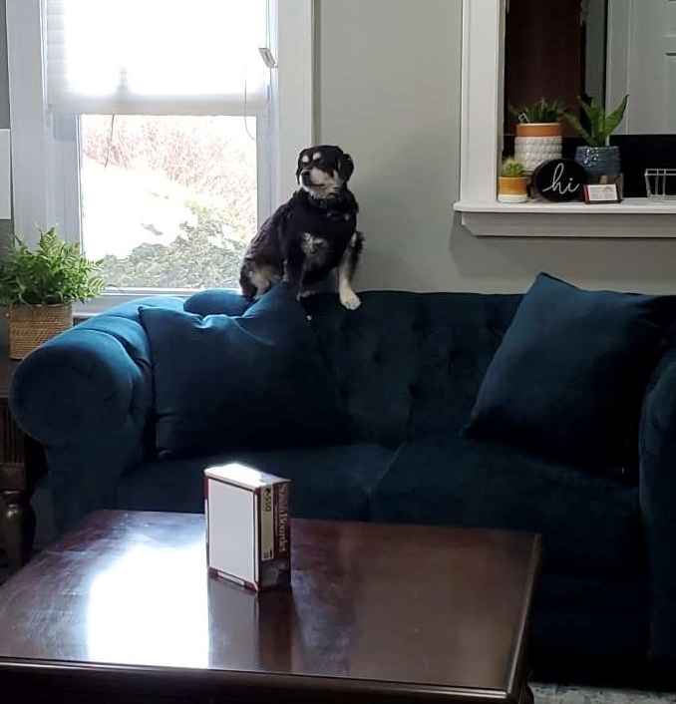
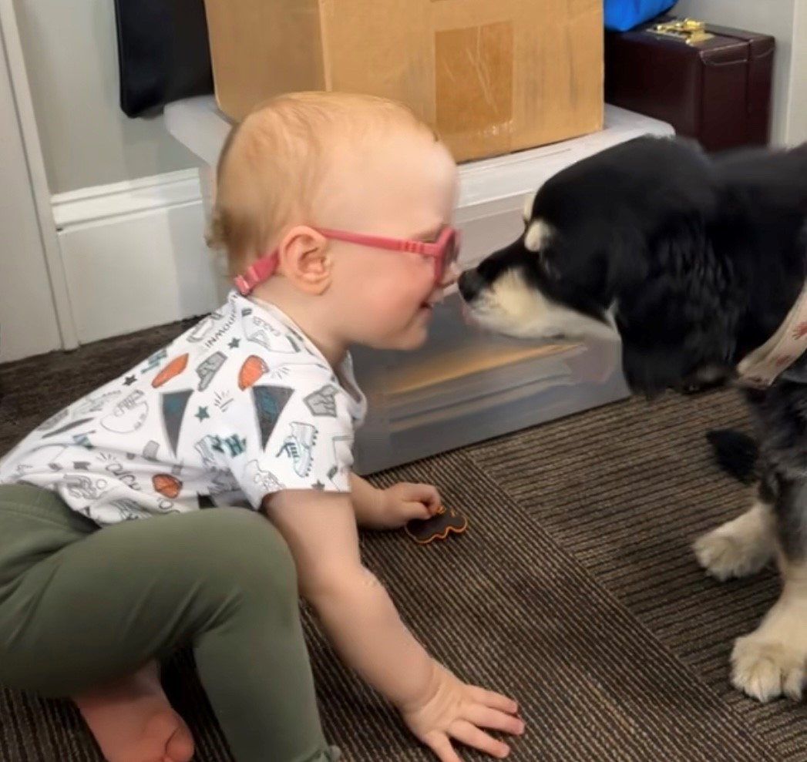
Sue’s Dog: Dory aka the guard dog of Sciota
Dory says: “This is my favorite visitor!”

Slide 4
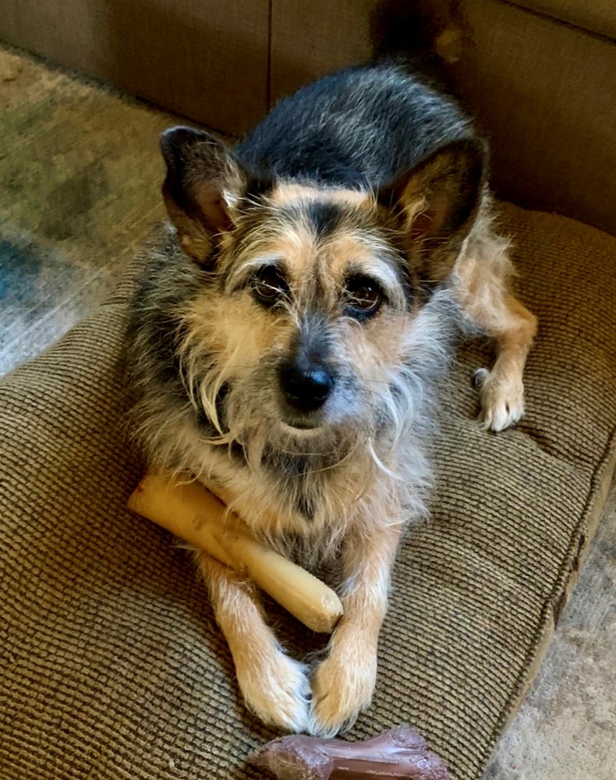
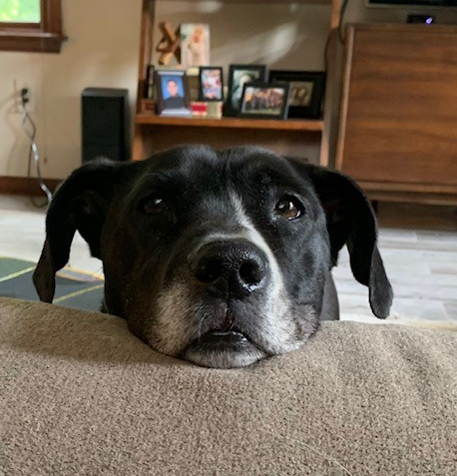
Happy Howlidays!
Stephanie’s Dogs: Daisy and Gibby

Slide 5
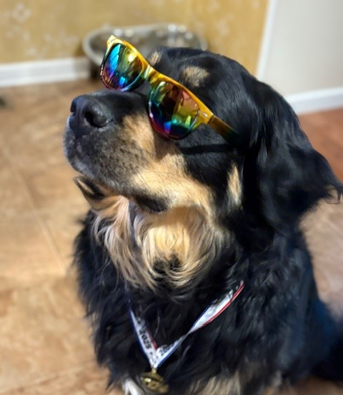
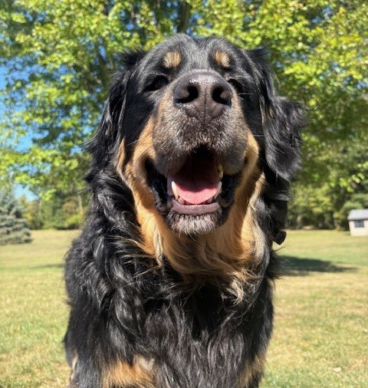
Alyssa’s pet bear dog, Murphy
Murphy is the coolest pup there is!

Slide 6
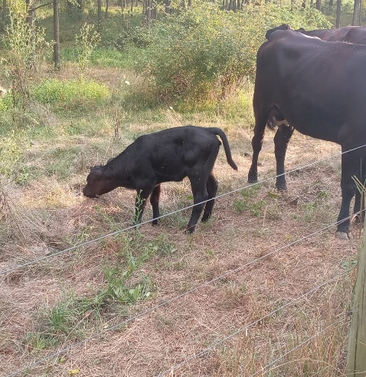
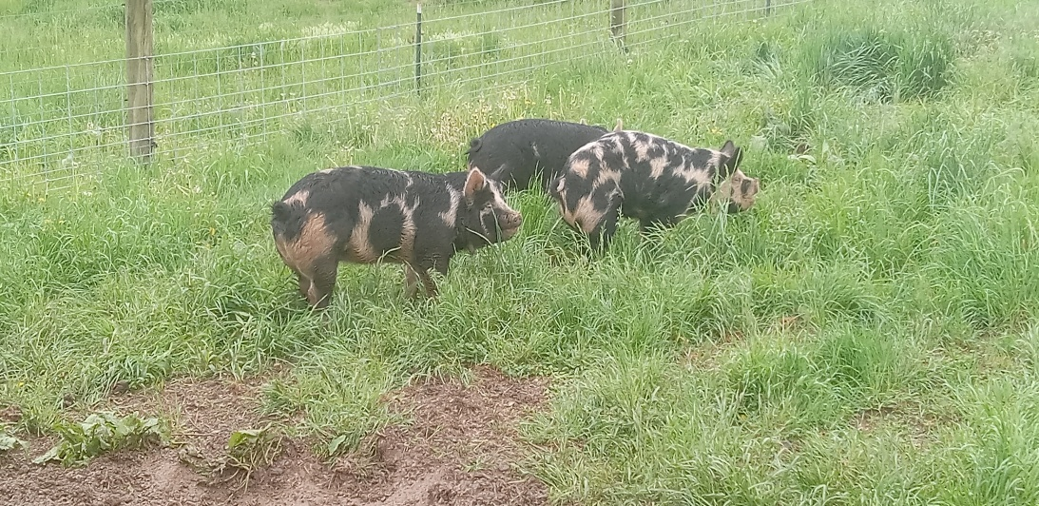
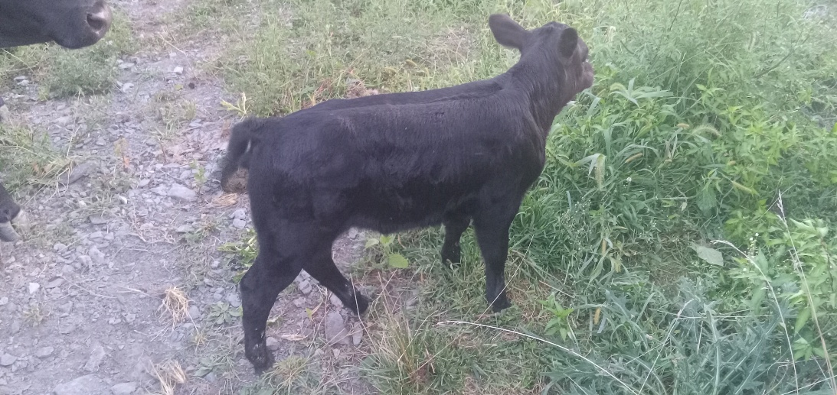
Is a cow that recently gave birth…de-calf-inated?
Meat Daryl’s pets

Slide 7
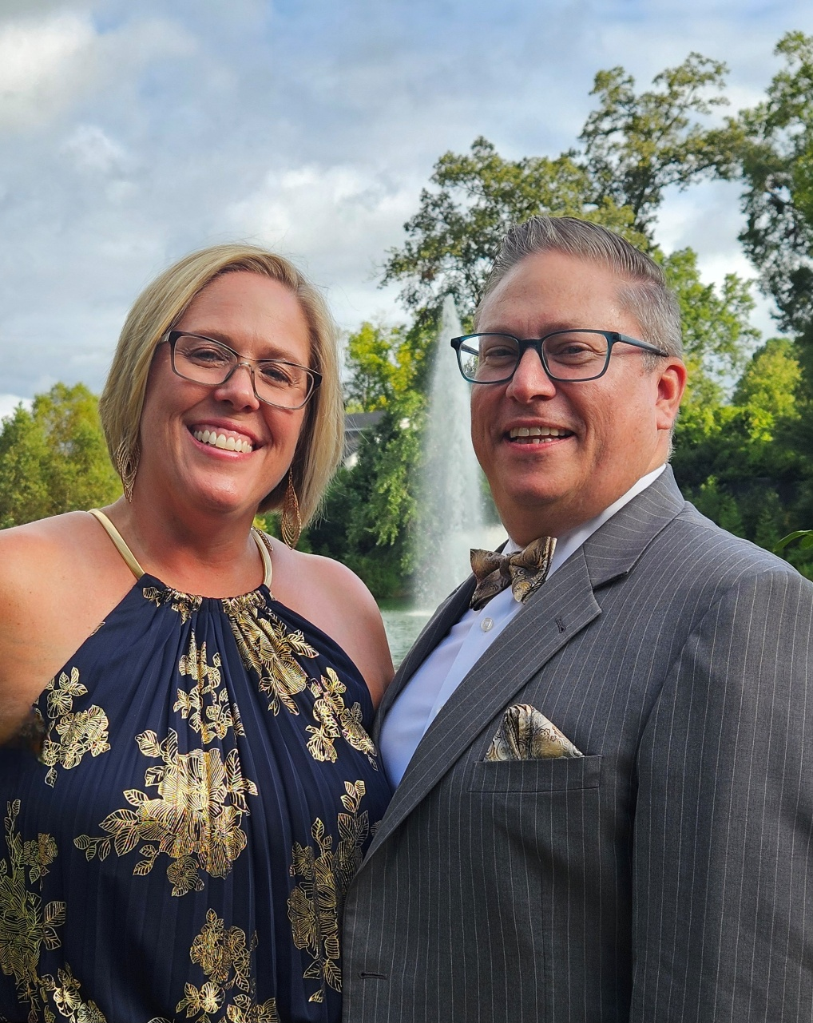
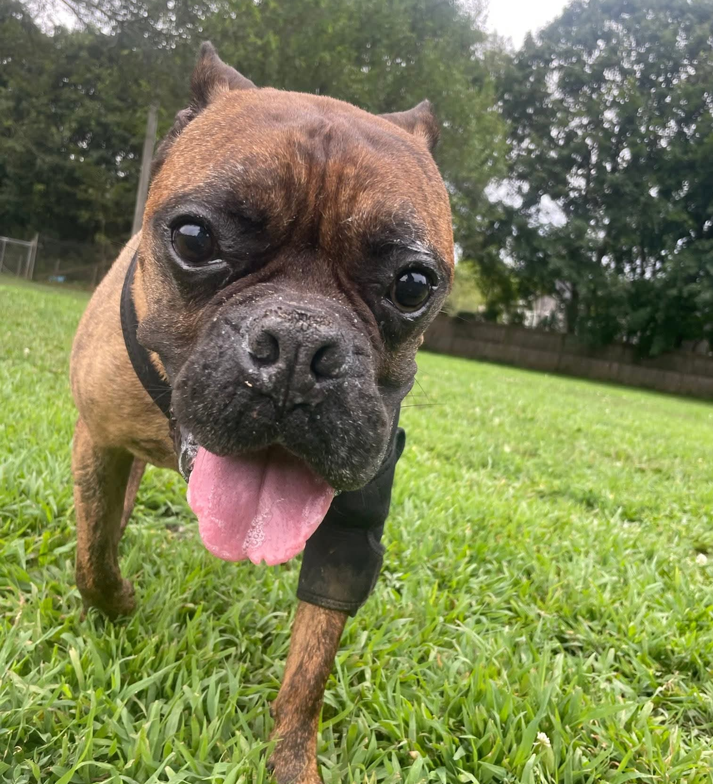
The Rupprechts
Their fur son, Teddy!

Slide 8
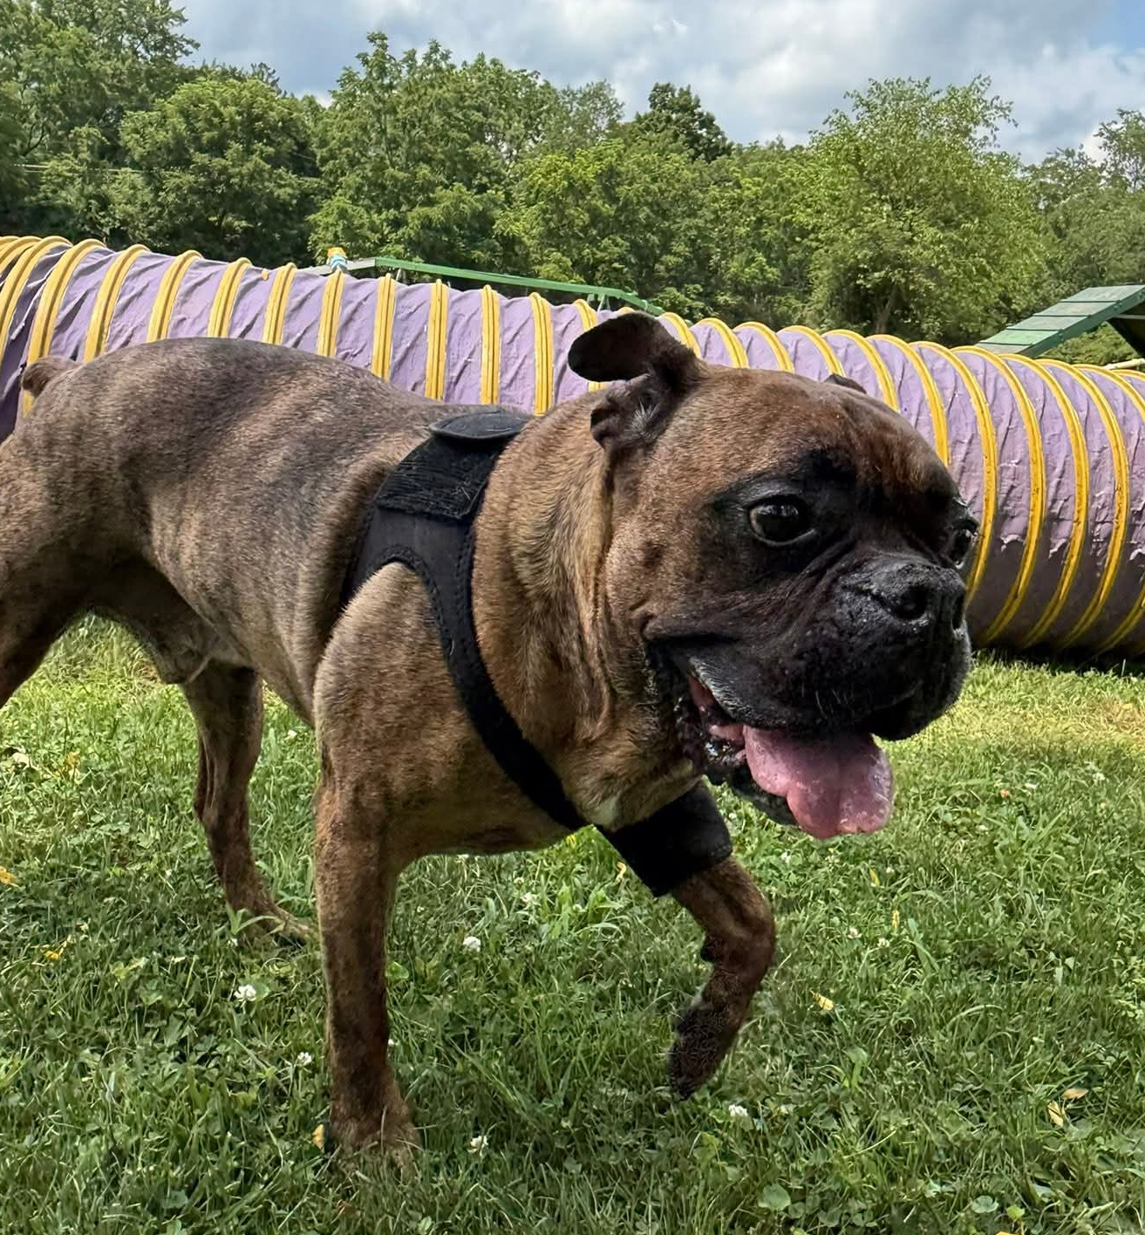
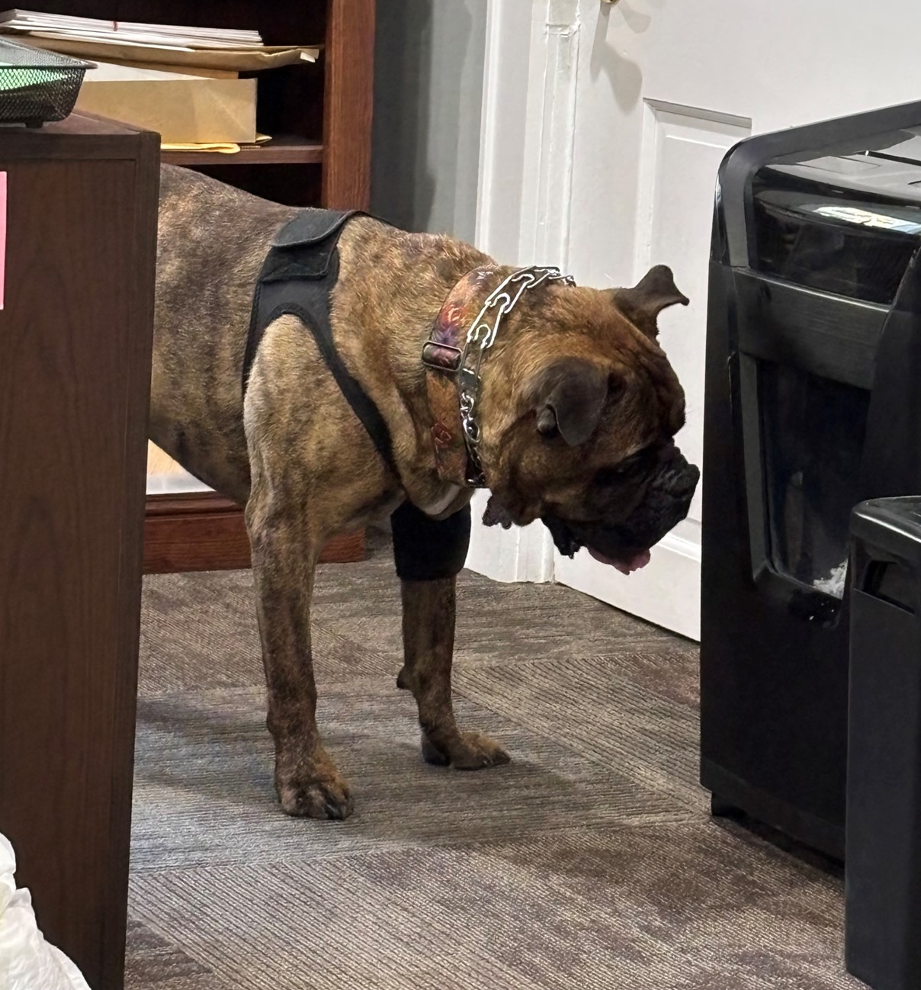
Teddy offering to help the shredder rip up our documents
Mister Teddy loves him some exercise!!

Slide 9
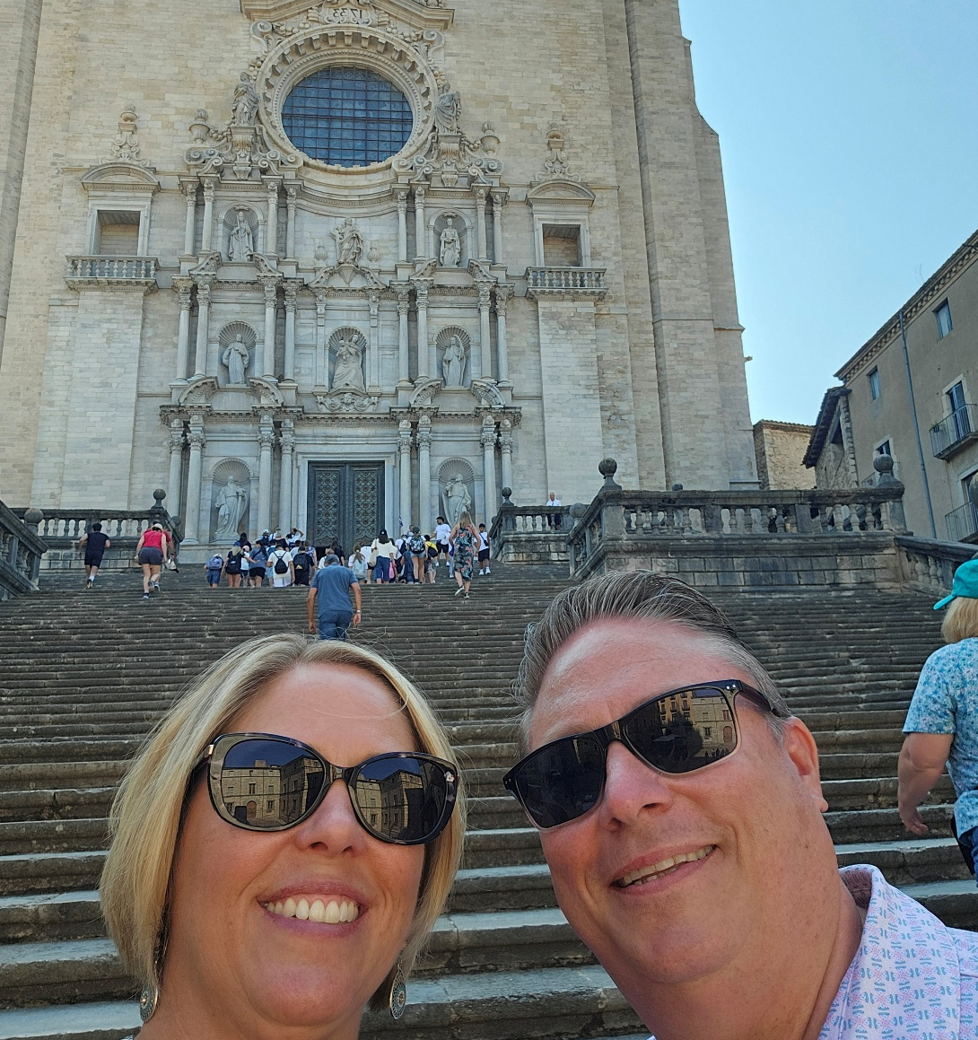
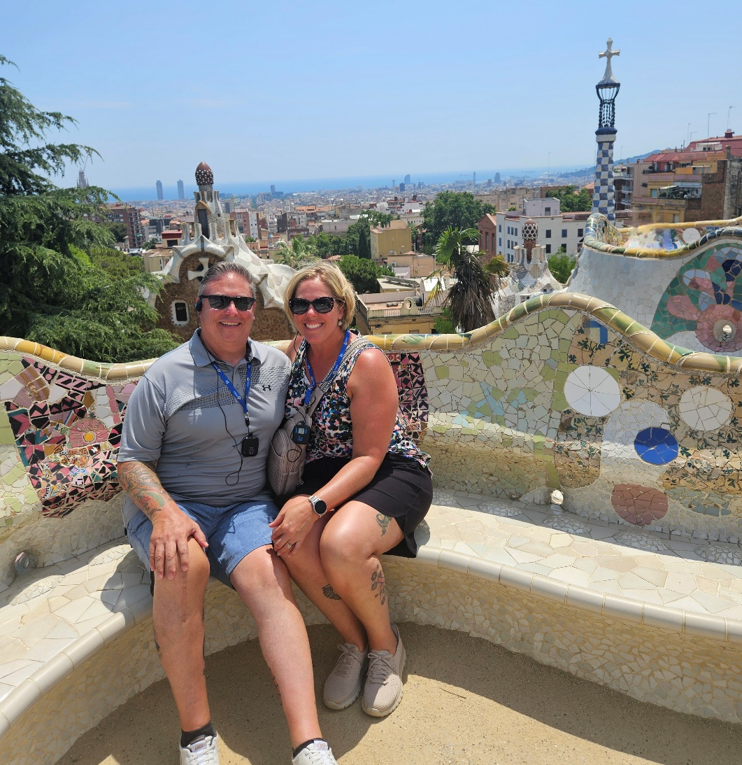

The Rupprechts had some European adventures
It’s pronounced “Barthelona”

Slide 10
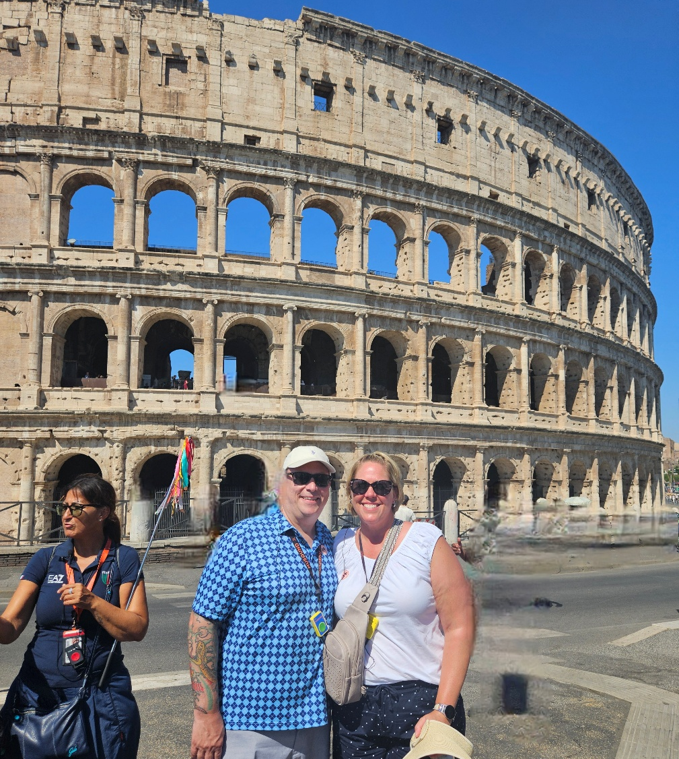
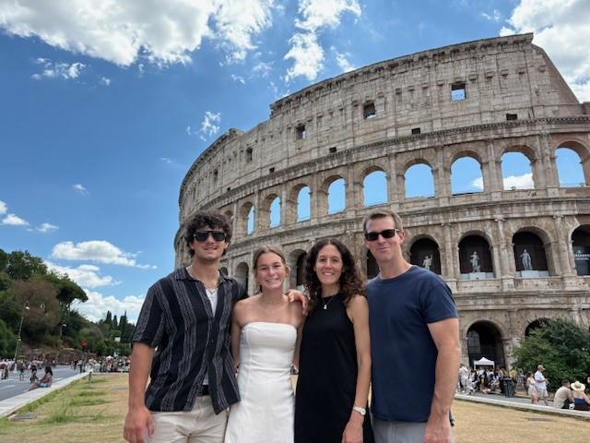
Both the Rupprechts and the Youngs saw the Colosseum
Who wore it better???

Slide 11
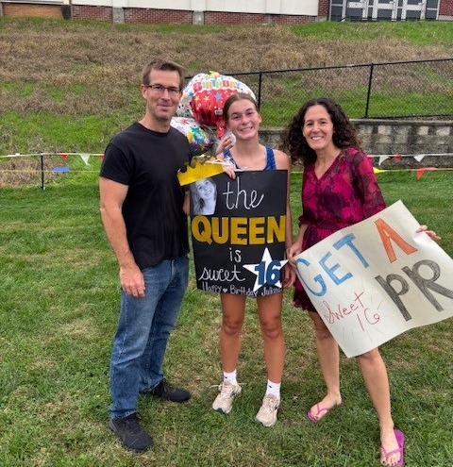
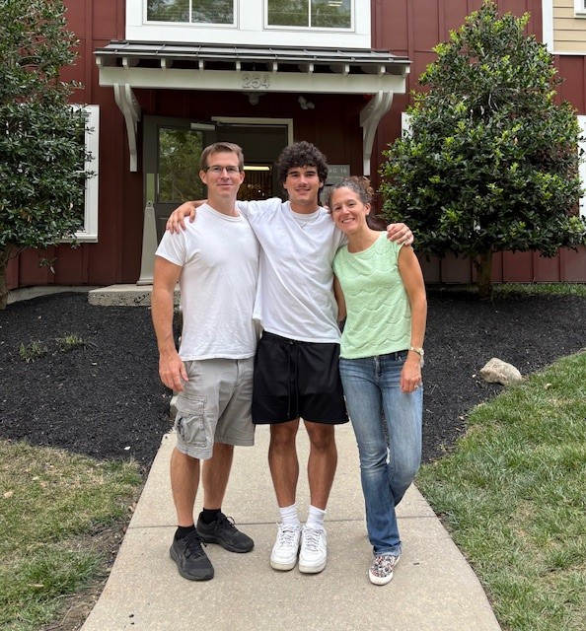
Alyssa’s son is already a junior at West Chester University…Go Rams!!!
Her daughter, Juliana, celebrated her Sweet 16th with a running PR!

Slide 12
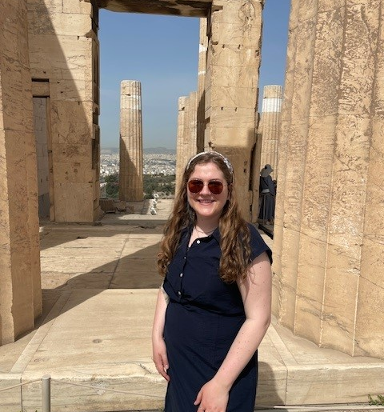
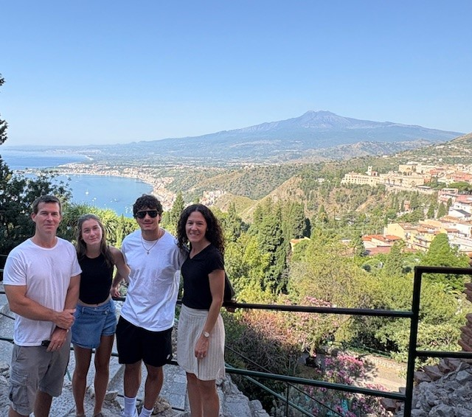
The Youngs Romed through Italy this summer
This is Melissa, who is often mistaken for Alyssa, also exploring the Mediterranean

Slide 13
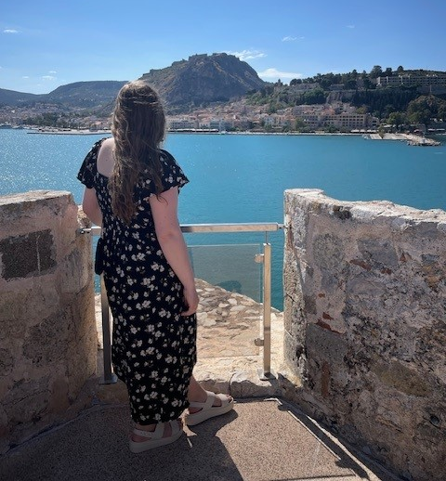
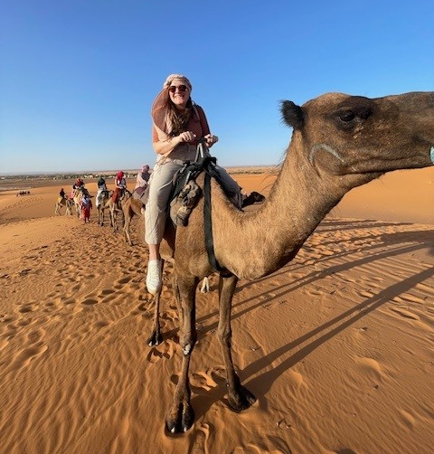
She still has sand in her shoes after Morocco this fall!
Melissa’s approach to math: “It’s all Greek to me!”

Slide 14
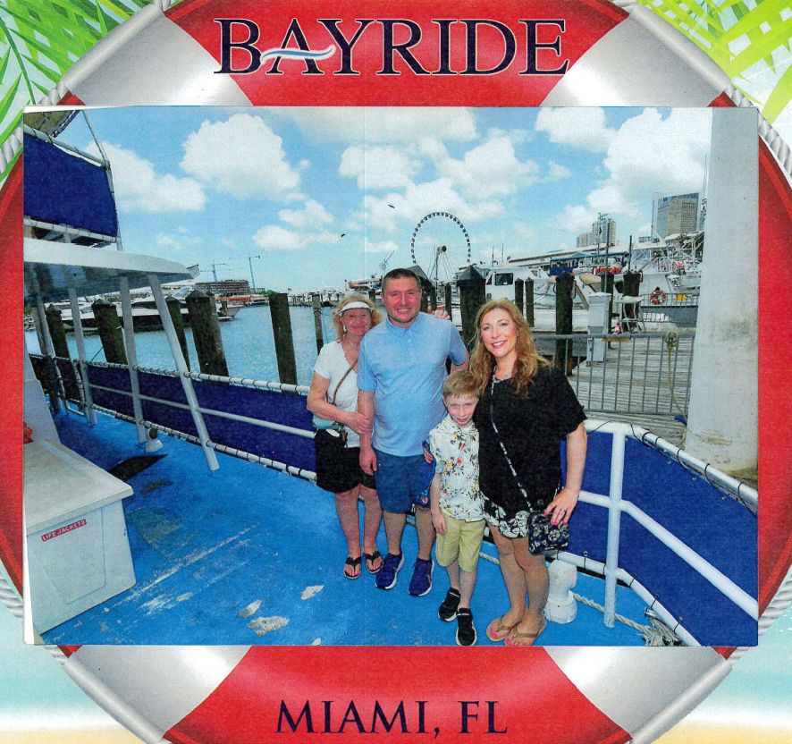
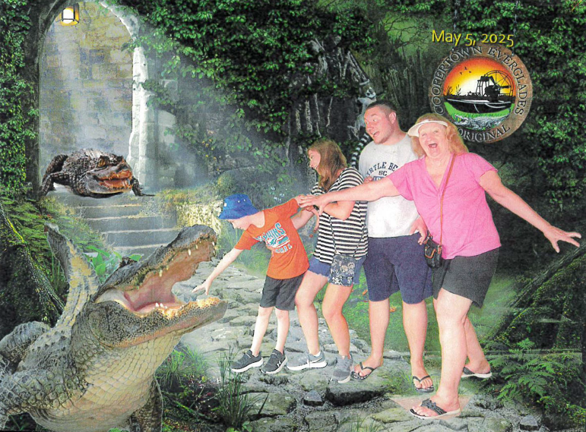
Connie and her beautiful family in Miami!
Watch out for those gators!

Slide 15
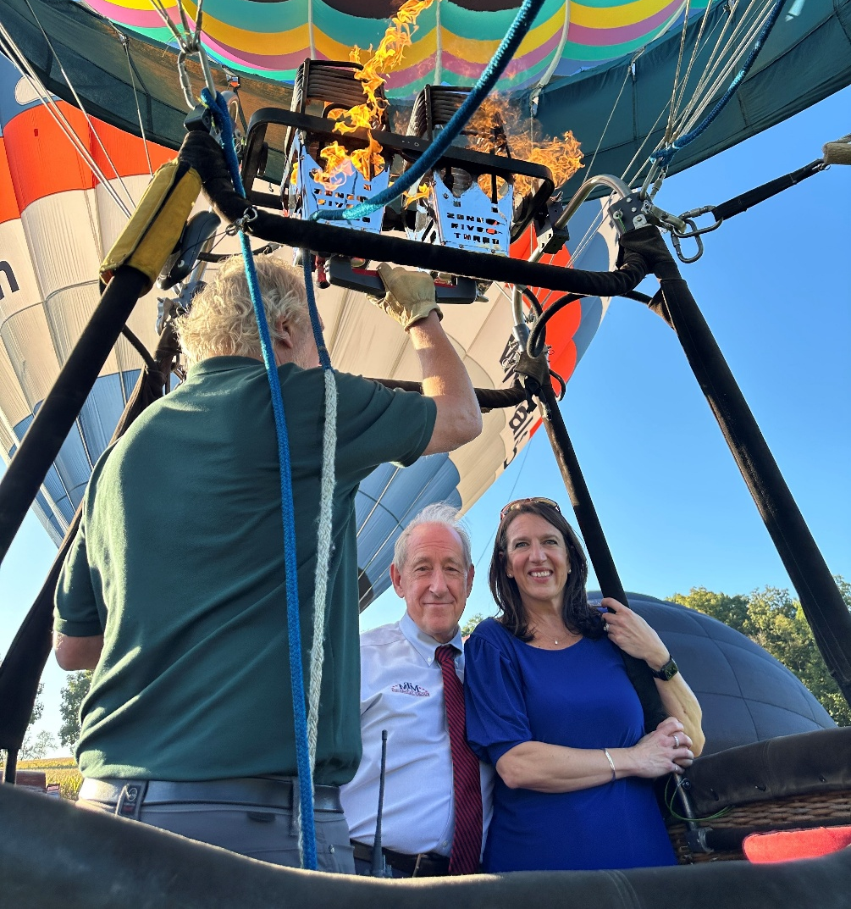
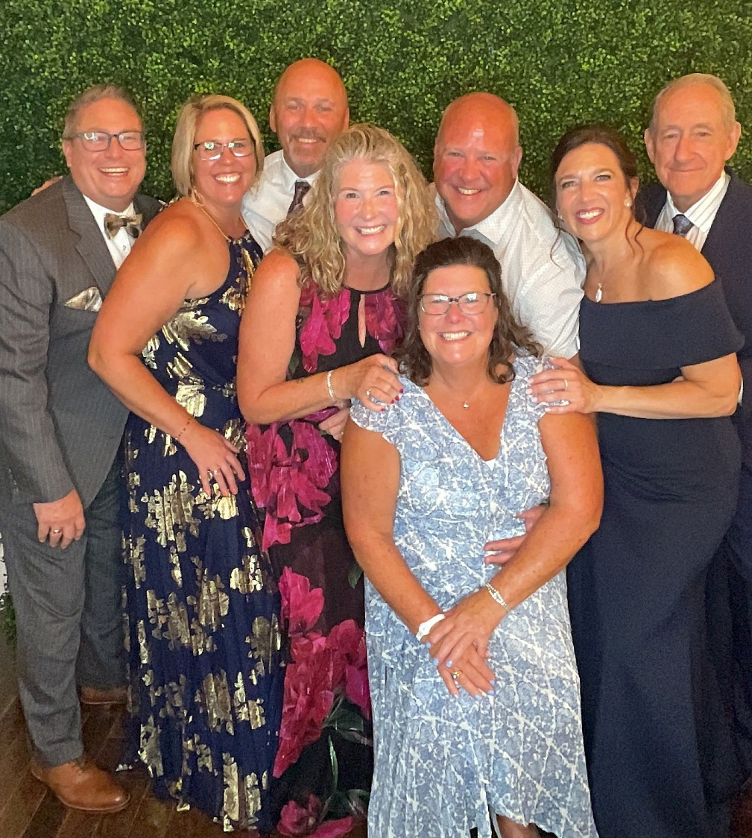
That’s one way for Gene to increase his “on air” time
The Dickison’s daughter, Dr. Alyssa, got married this year

Slide 16
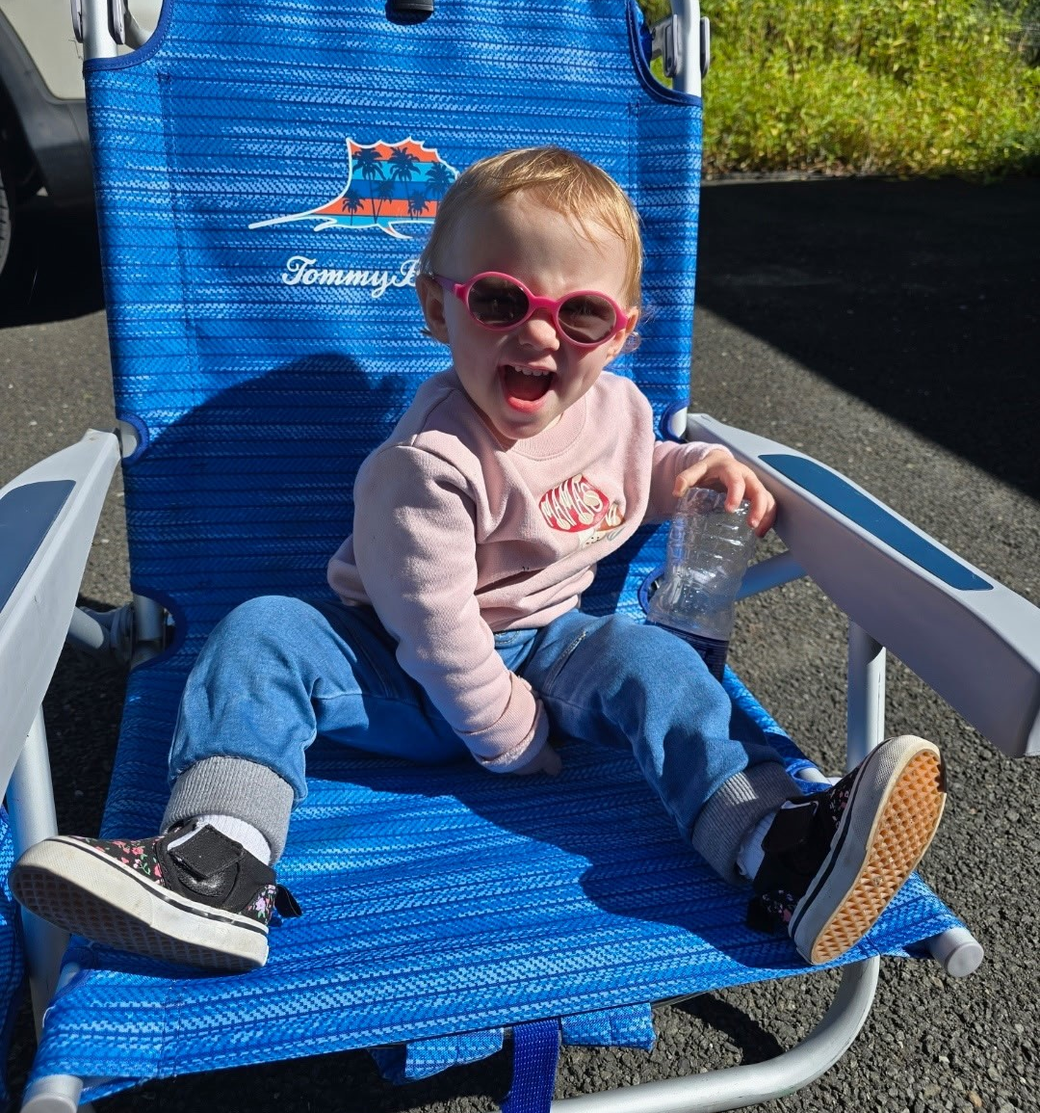
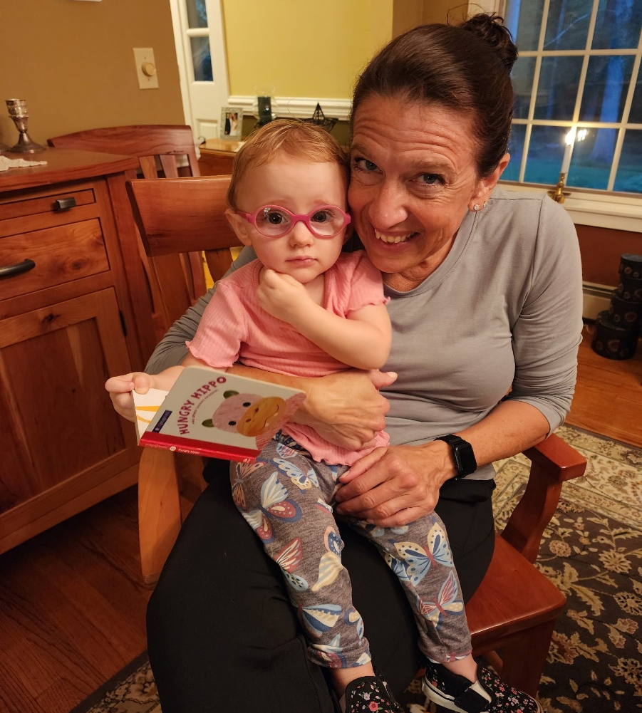
The Dickison’s granddaughter is getting so big!
Annabelle loves her DeeDee!

Slide 17
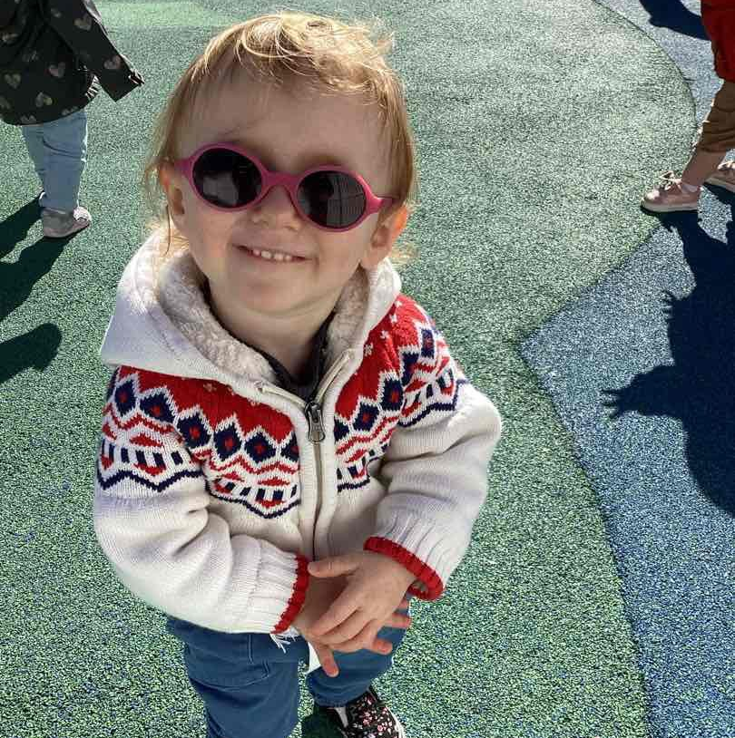
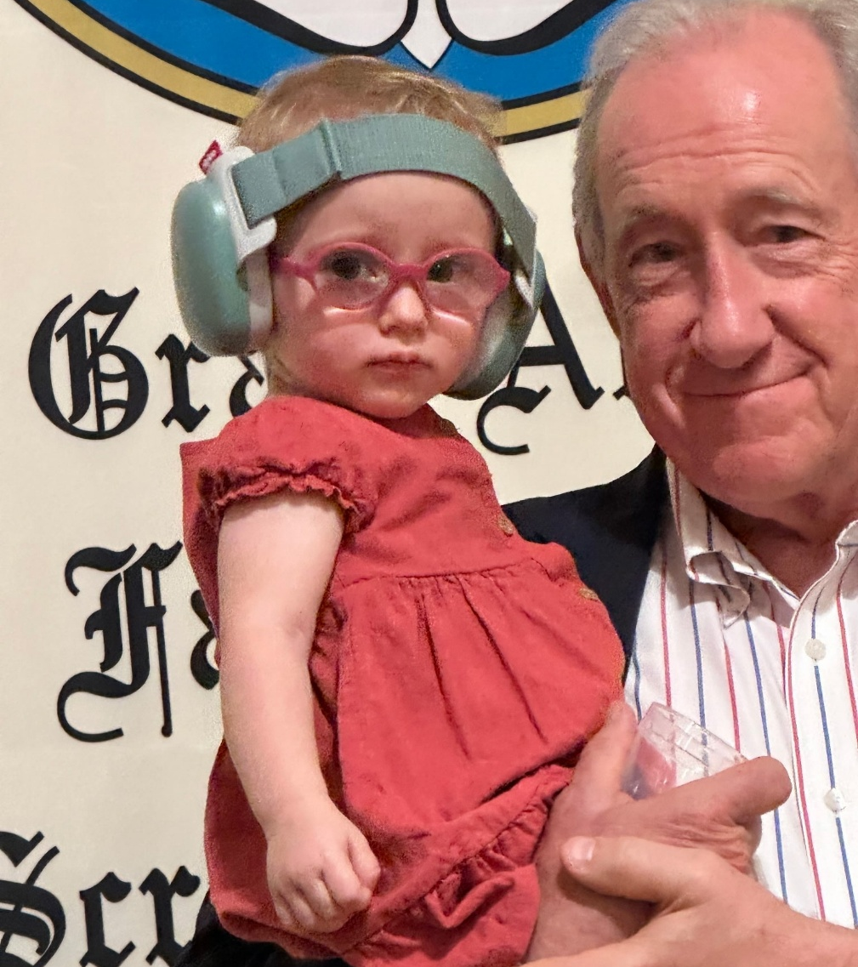
She is rocking the transition glasses at Pre-School!
Gene and his gorgeous granddaughter, Annabelle!

Slide 18
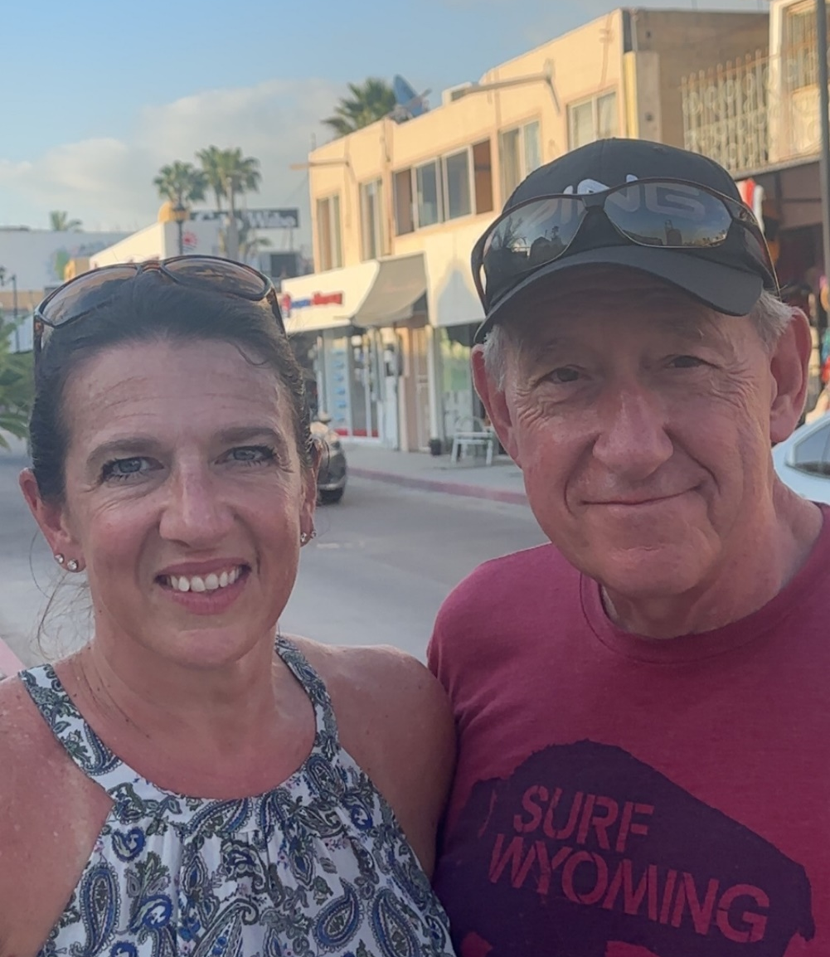
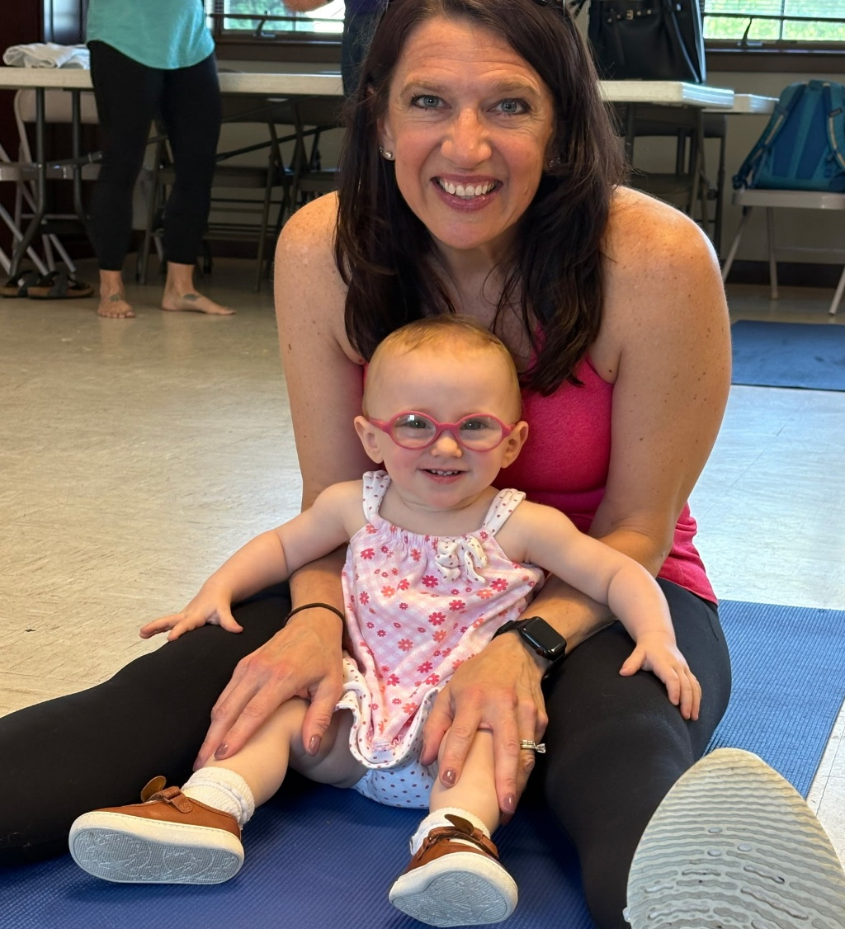
Gene & Diane during their trip in Mexico!
Invest-In-You’s youngest member

Slide 19
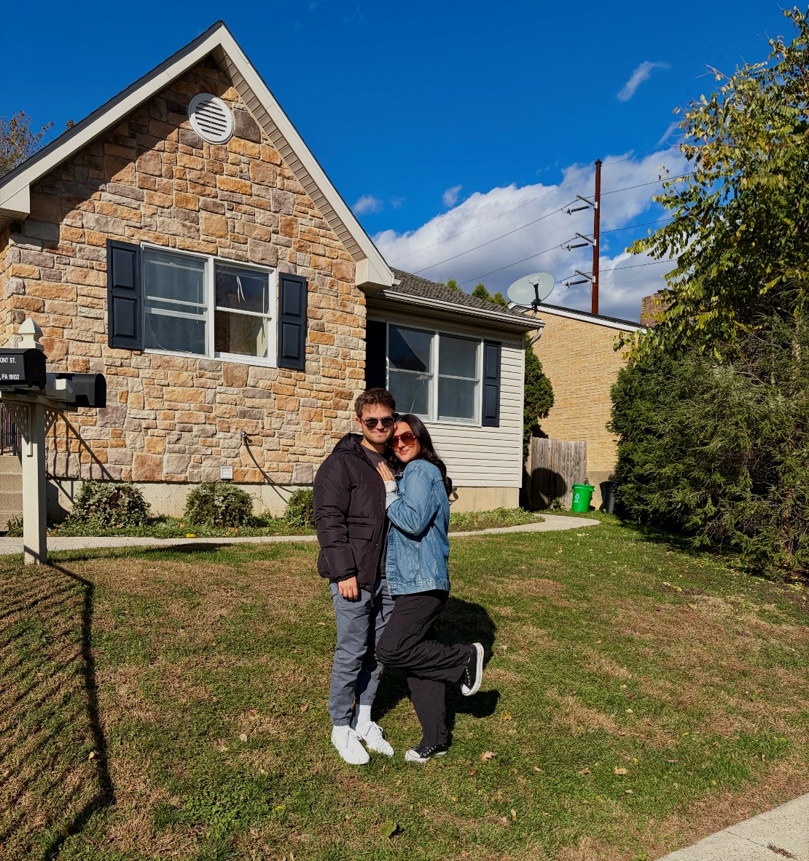
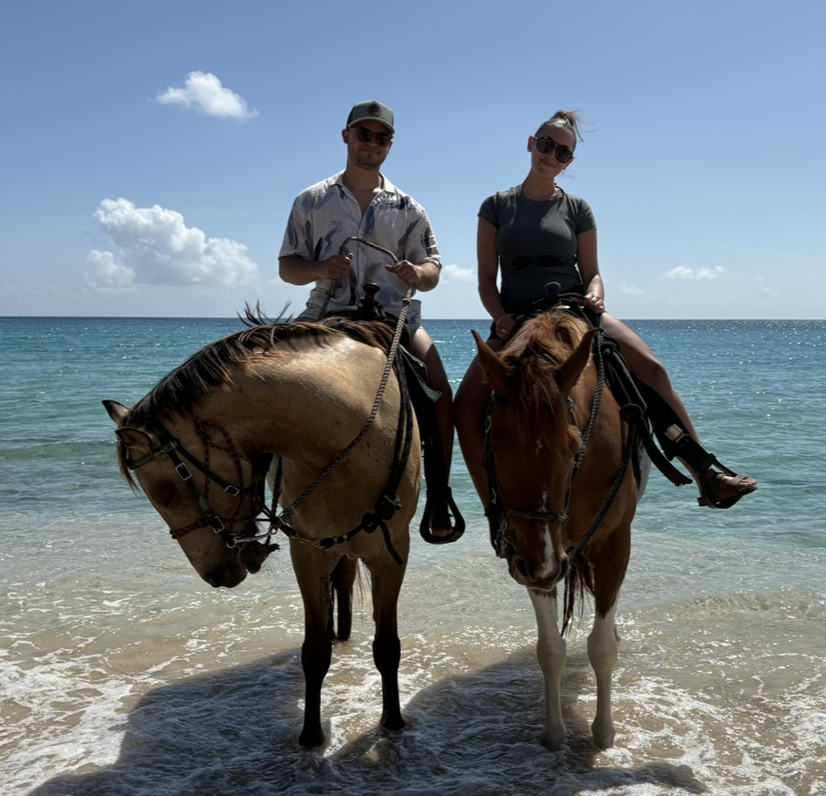
Meet our new team member Makaila! Her and her boyfriend, Zach, just moved into their first home
Zach & Makaila:
St. Croix 2025

Slide 20
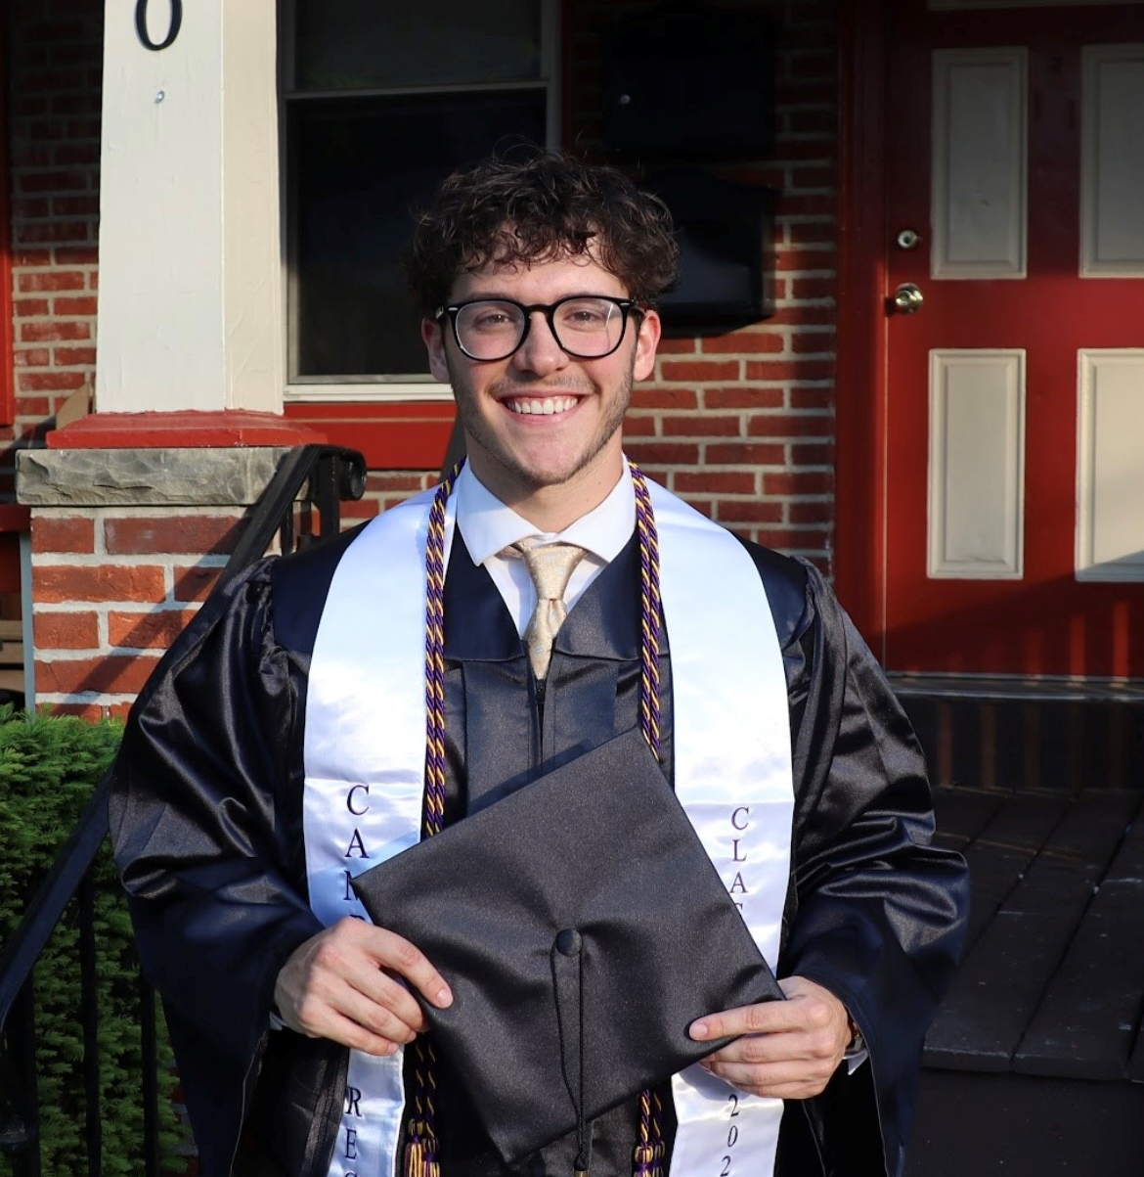
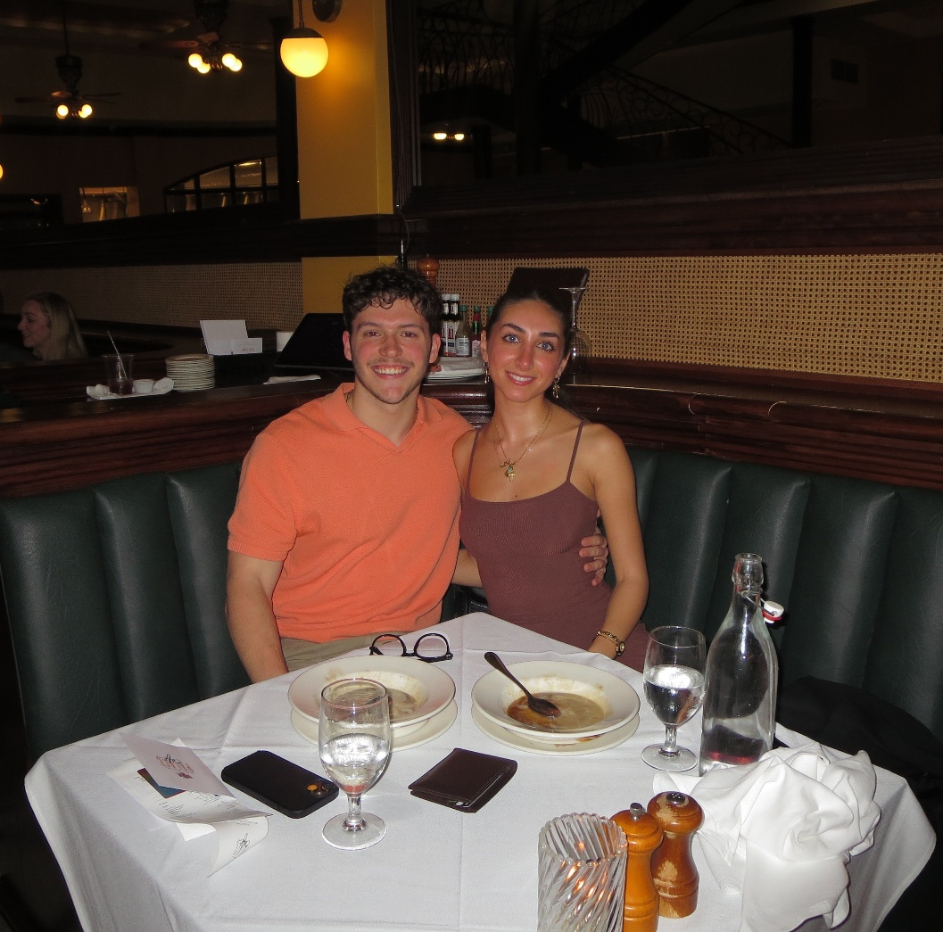
Our other new team member Gavin! Makaila and Gavin are both recent West Chester Grads!
Gavin and Sabine:
New Orleans 2025

Slide 21
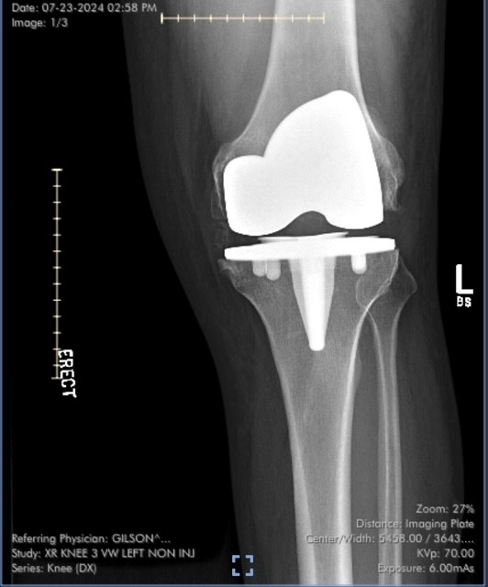
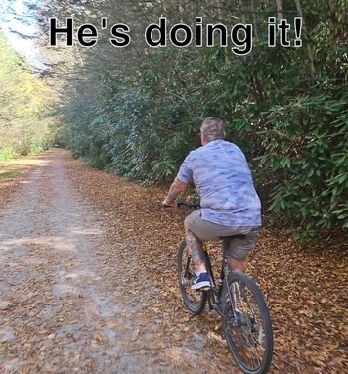
Our last new team member: Chad’s titanium knees
Taking the new knees out for a spin!

Slide 22
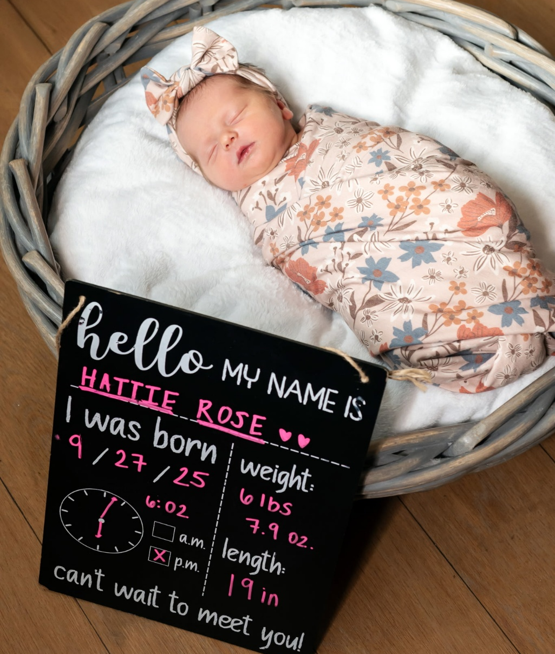
Daryl welcomed his 3rd grandbaby, Hattie, this year!

Slide 23
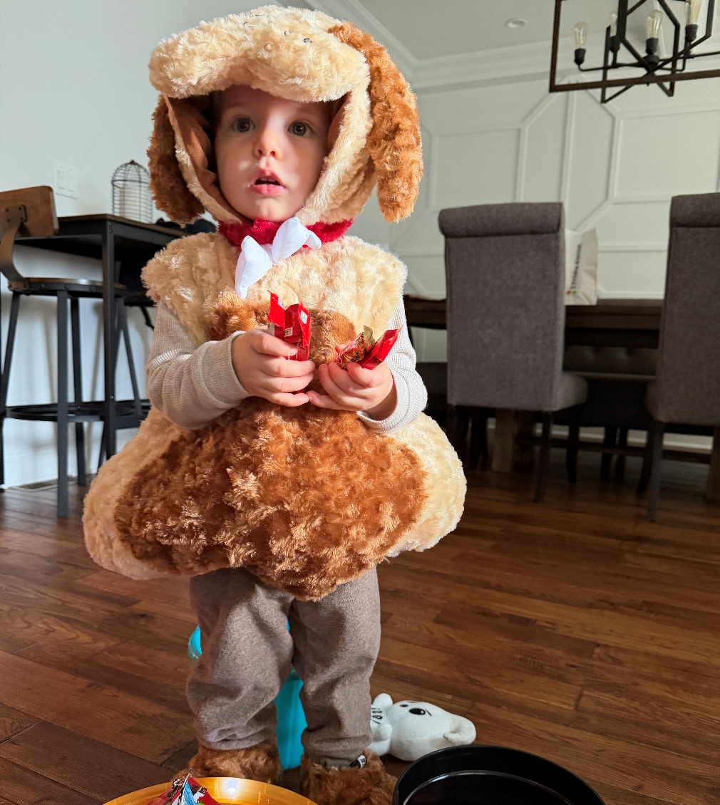
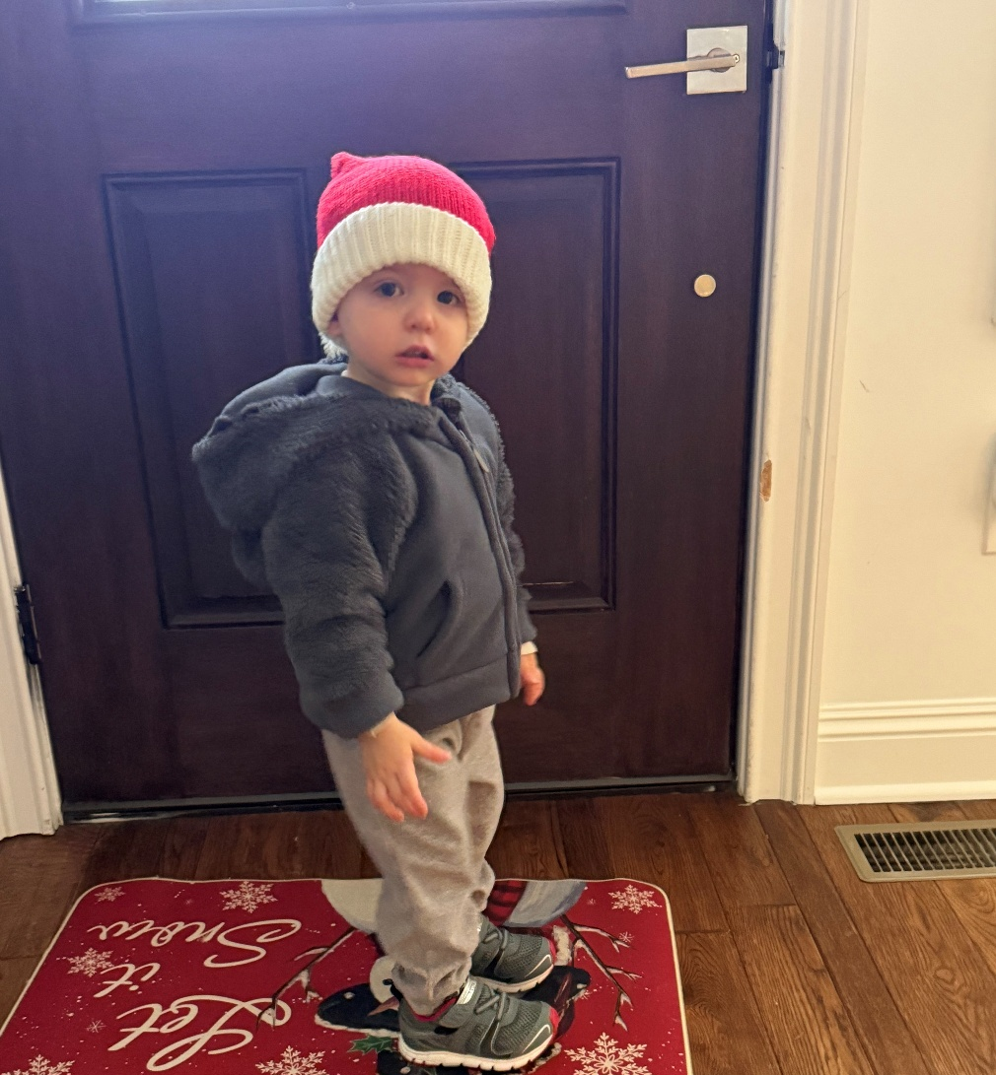
Mark’s little pup, Nico, is ready to fetch all of the Halloween treats!
Officially the cutest little Santa’s helper around!

Slide 24
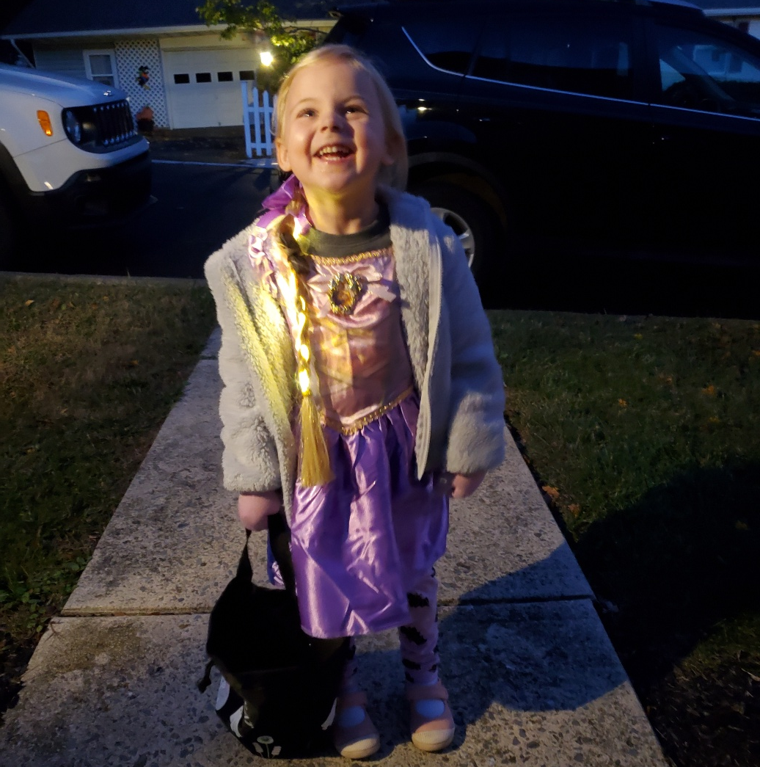
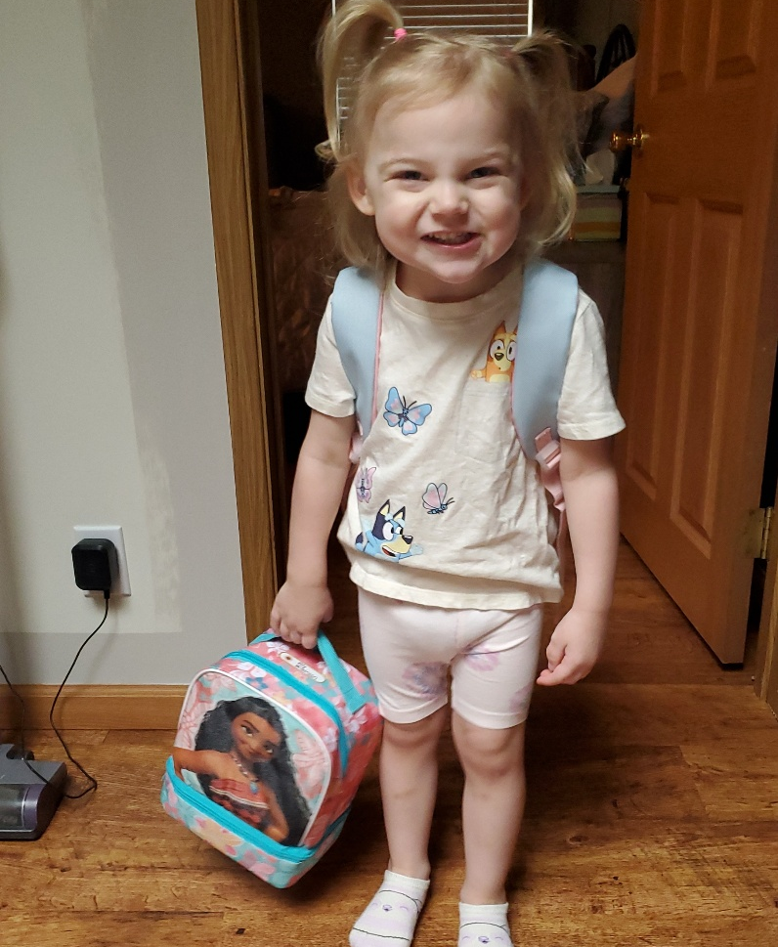
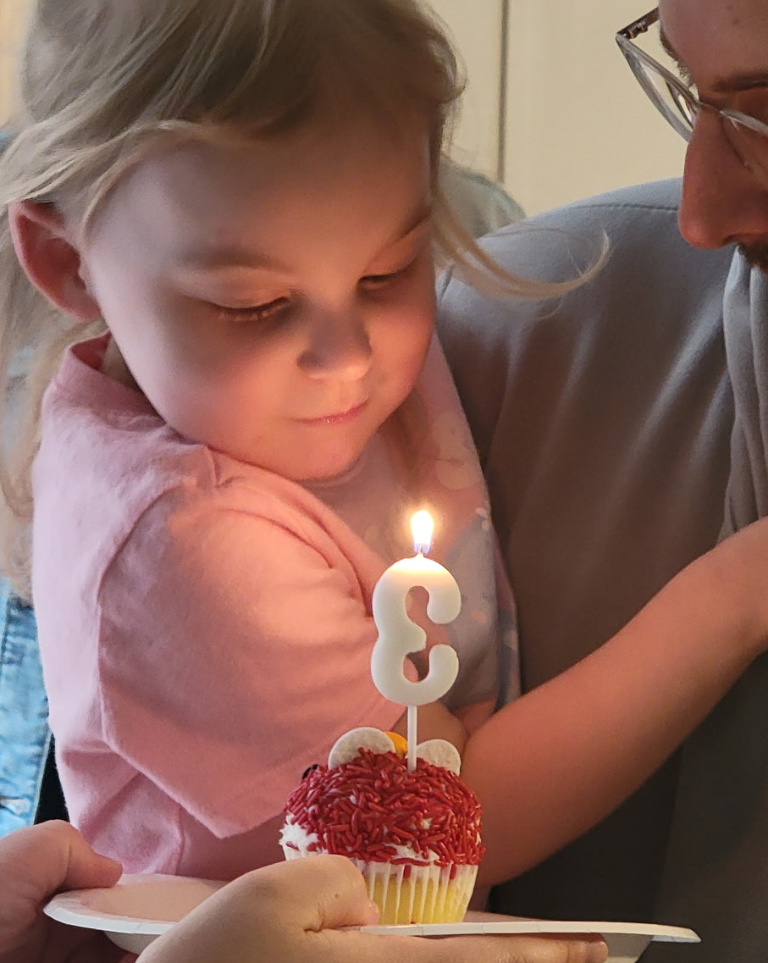
Ally dressed as Rapunzel for Halloween 2025
And celebrated her first day of Preschool!
Rachelle’s Daughter Ally turned 3!

Slide 25

A Hawaiian Sandwich of the Grillo Family

Slide 26
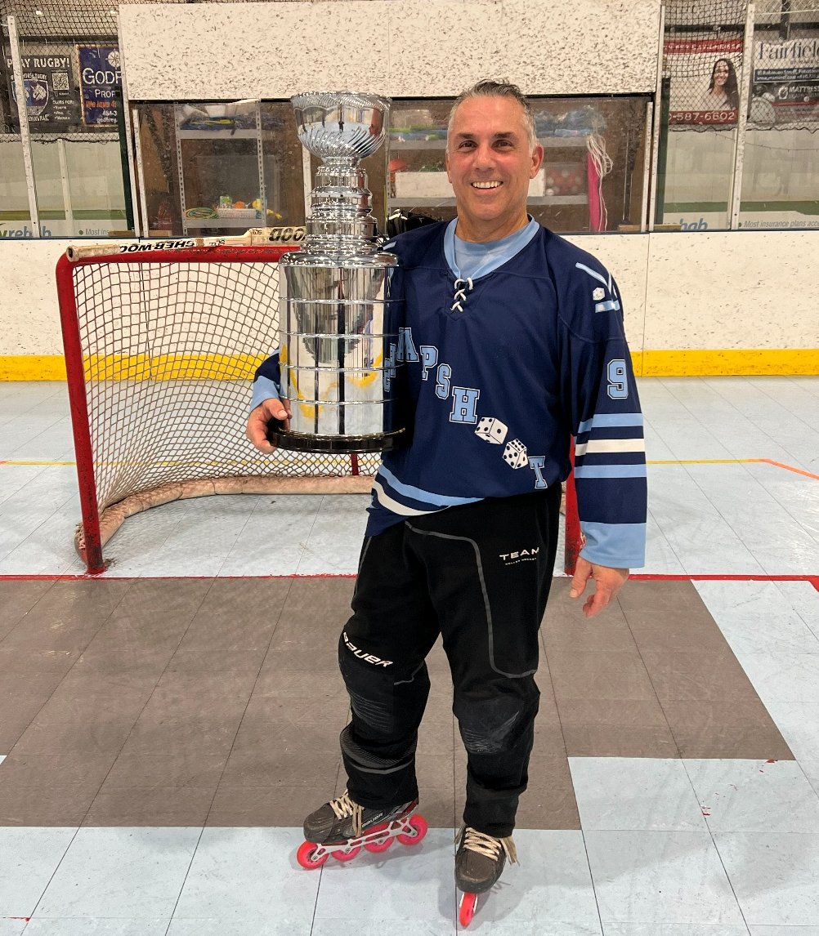
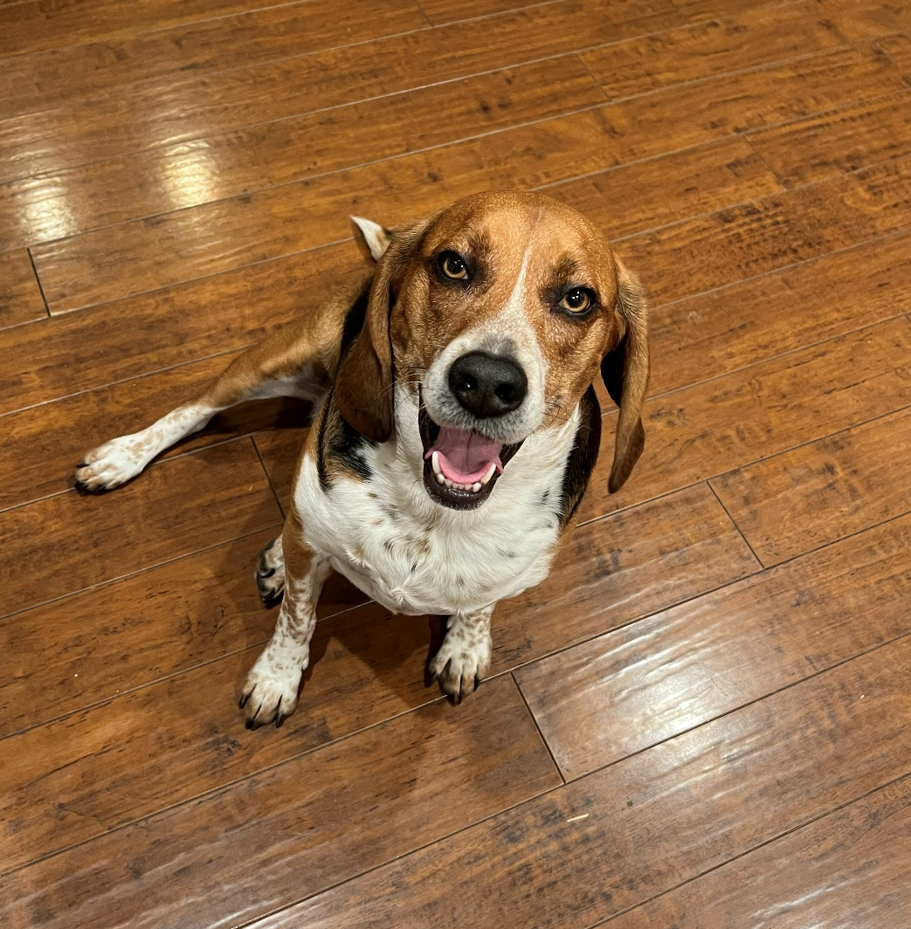
Greg: an All Star on and off the ice
Greg’s little sidekick, Frank!

Slide 27
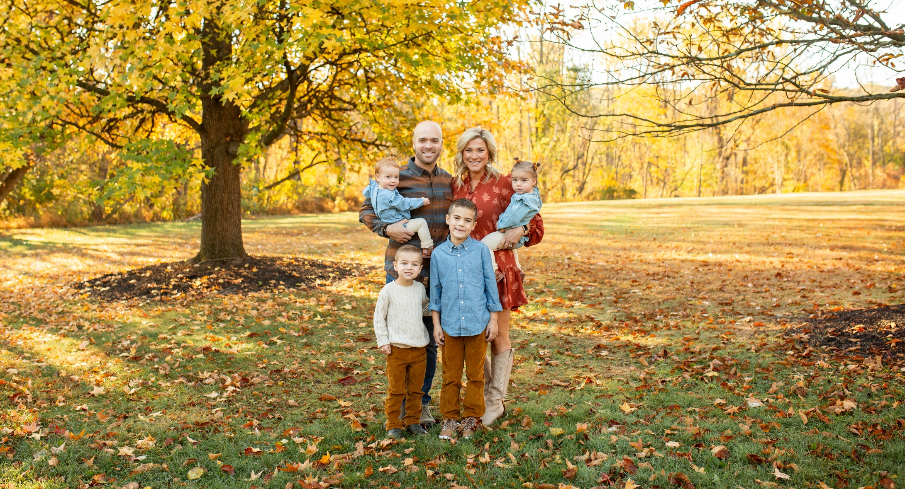
The Weimer’s

Slide 28


The Four Musketeers
We still don’t know how Jon and Sarah got them all to look at the camera at the same time

Slide 29


Sue’s family visited Lego Land
Family = Home ☺

Slide 30


Stephanie’s daughter, Emma, won a science award this year!
Stephanie’s two kids, one sweet moment

Slide 31

The Ly Family

Slide 32


Tammy’s son, Eric, got married to his beautiful wife, Jamie, last weekend!
Tammy has always been his “Perfect Fan”

Slide 33


Rare sighting:
Tammy wearing her glasses!
Kiet, Tammy, Olivia and her fiancé John!

Slide 34


Desert days with Tammy and her favorite travel partner, Kiet
Tammy and her favorite people – all aboard for good times!

Slide 35

Some of our team got a little sunshine while attending a conference in Florida this February.

Slide 36


MtM Hosted LAMN’s “Run, Walk, & Roll”
MtM’s Invest In You Plant Party!

Slide 37


All of your help means the world to us! Thank you
Alyssa organizing the Invest-In-You Shoebox event!

Slide 38

2025’s Event is happening on Thursday, 12/11!
Please ask us if you want to learn how to get involved
We had over 120 shoe boxes from the 2024 Invest-In -You donations thanks to all of you!!

Slide 39
Thanks for being a part of our MtM family,
xoxo

